Slide 1


Team 26: HEAR NOW
As nurses, we fundamentally believe that our patients benefit when they see the images and hear the voices of their loved ones.

Slide 2

Team Members
Molly Higgins, RN, BSN Team Lead Hematology/Oncology/Bone Marrow Transplant
Kelly Ayala, DNP, BSN Adult Gero NP, ICU Nurse
Rosemarie Yetman MSc, RN Emergency Nurse, RN Strategist
Sabine Clasen, MSN, RN, CHPN Palliative Care Nurse
THANK YOU, MENTORS!

Slide 3
Problem: Due to visitor restrictions, families are unable to be at their loved one's bedside.
Participation is limited
Timing isn't ideal for patient, family and nurse
Takes time to coordinate
Vital Connections Are Missed
The only options are scheduled video and phone calls

Slide 4

Any family member:
Capture and record multiple messages and videos upload them into a universal communication
platform.
Messages and videos are compiled throughout the day by friends and family members.
Solution:
Hear Now
Accessed and played at a time optimal for the patient and the nurse while providing patient care.
Notes:
Healthcare proxy can curate the messages coming into the patient.
Messages are gatekept by healthcare proxies & healthcare providers.

Slide 5
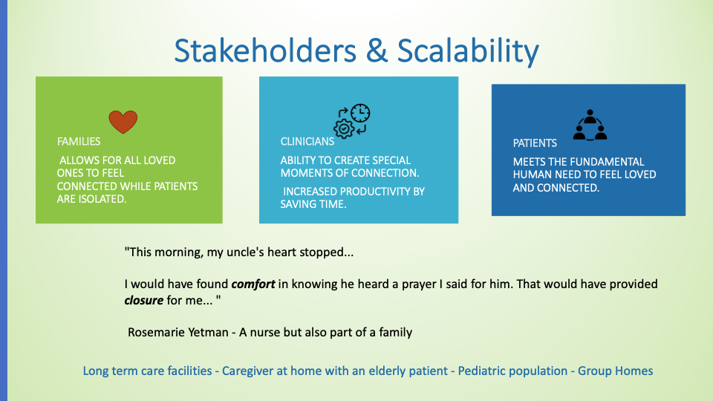

Slide 6
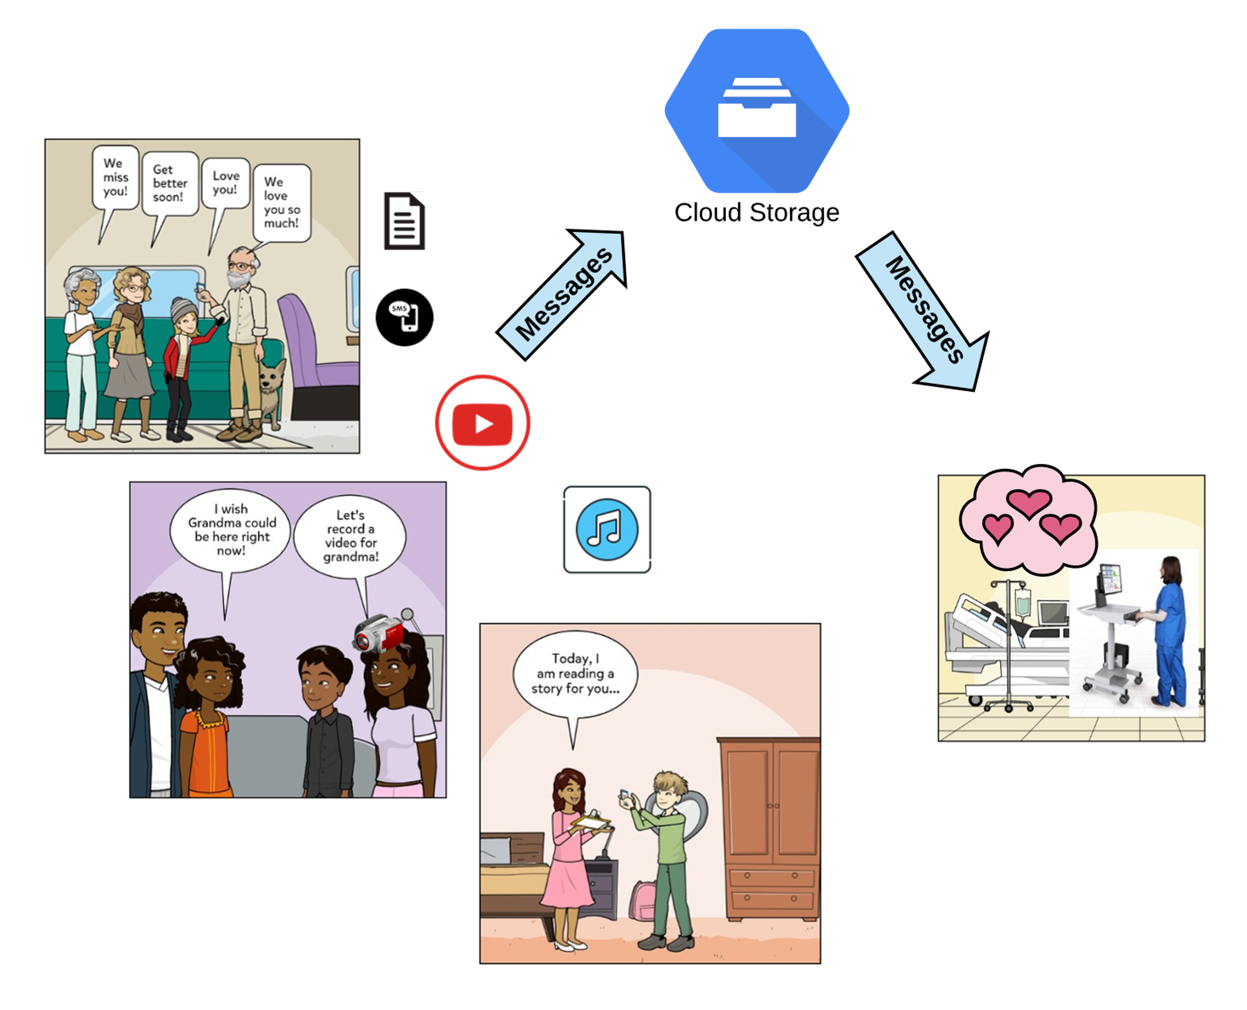

Although loved ones cannot be here now, patients can always HEAR them NOW

Slide 7

"Be Hear, Now."
Covid-19 may isolate us,
but it does not have to
disconnect us.

